Slide 1

OpenGL
By Praveen hore

Slide 2
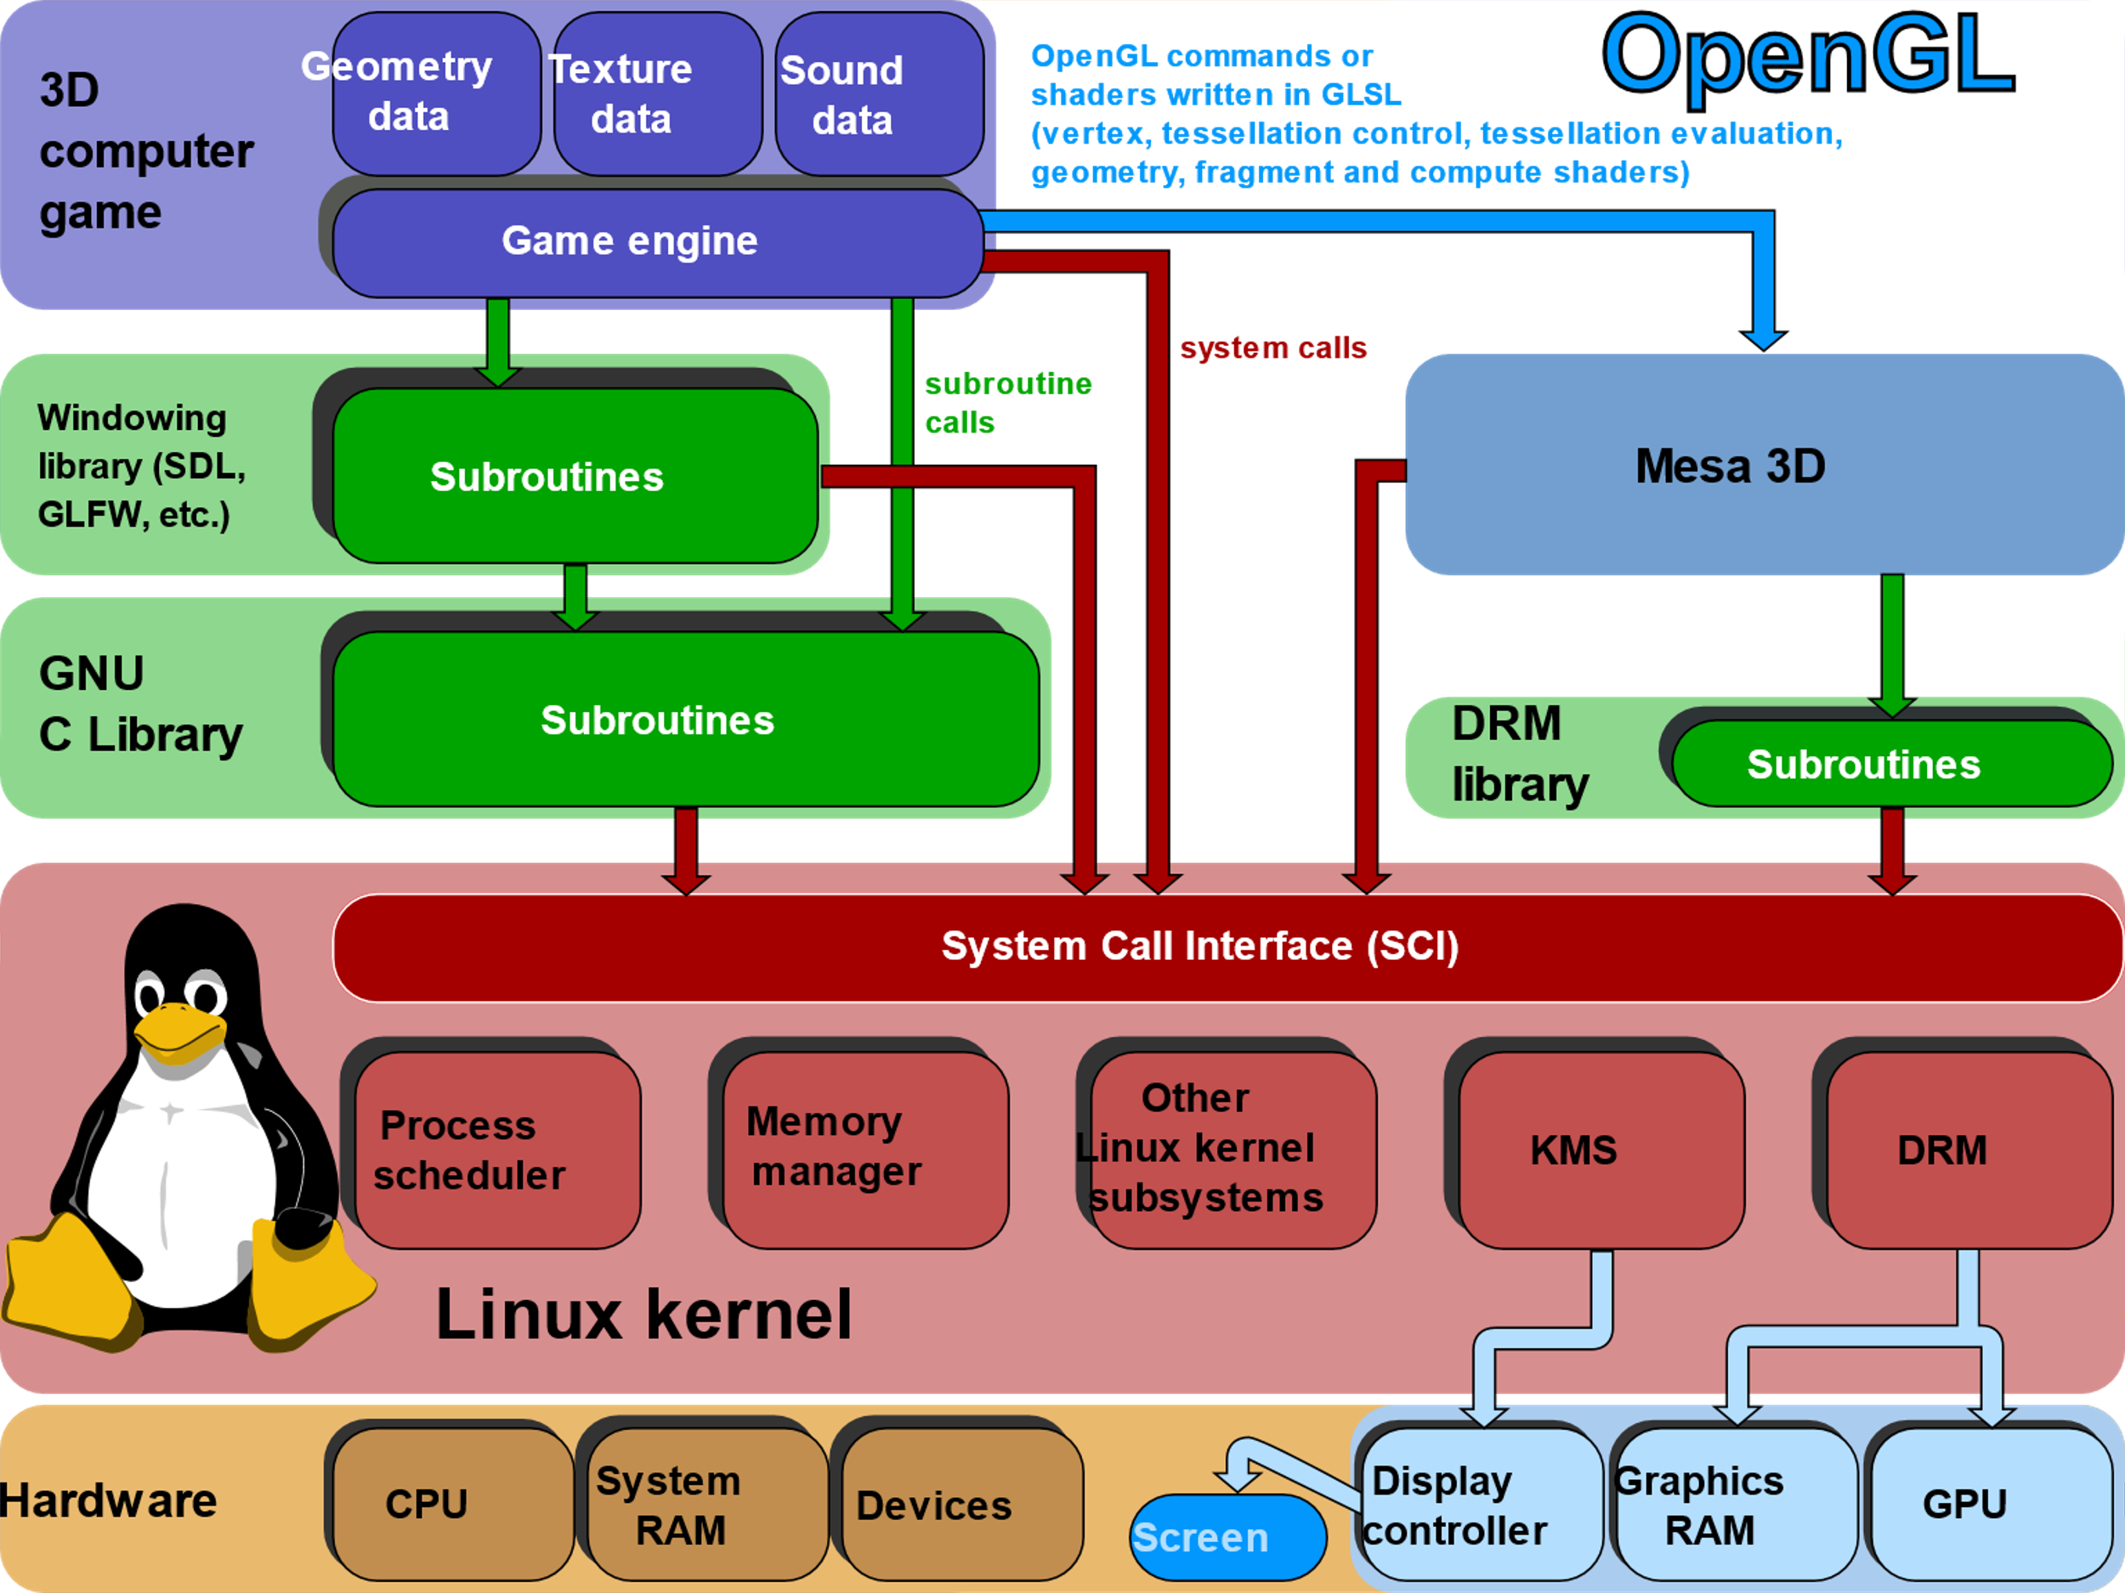
Introduction
Open Graphics Library (OpenGL) is a cross-language (language independent), cross-platform (platform-independent) API for rendering 2D and 3D Vector Graphics(use of polygons to represent image).
OpenGL API is designed mostly in hardware.

Slide 3
Features
Design : This API is defined as a set of functions which may be called by the client program. Although functions are similar to those of C language but it is language independent.
Development : It is an evolving API and Khronos Group regularly releases its new version having some extended feature compare to previous one. GPU vendors may also provide some additional functionality in the form of extension.
Associated Libraries : The earliest version is released with a companion library called OpenGL utility library. But since OpenGL is quite a complex process. So in order to make it easier other library such as OpenGL Utility Toolkit is added which is later superseded by free glut. Later included library were GLEE, GLEW, and gliding.
Implementation : Mesa 3D is an open source implementation of OpenGL. It can do pure software rendering and it may also use hardware acceleration on BSD, Linux, and other platforms by taking advantage of Direct Rendering Infrastructure.

Slide 4

Installations steps
On Ubuntu:
Step 1. sudo apt-get install freeglut3 freeglut3-dev
Above step will install the development libraries of OpenGL/Glut in Ubuntu:
Step II: sudo apt-get install binutils-gold (optional)
For newer versions of Ubuntu (>= 11.10) you have to install another package because the linker does't link anymore.

Slide 5
on windows in Code::Blocks
Download code block and install it
Go to the https://www.transmissionzero.co.uk/software/freeglut-devel/ and download zip file from the download link that appears after freeglut MinGW package with having link name as Download freeglut 3.0.0 for MinGW and extract it.
Open notepad with run as administrator and open file from
This PC > C:(C-drive) > Program Files(x86) > CodeBlocks > share > CodeBlocks > templates, (then click to show All Files)
Next, open glut.cbp and search all glut32 and replace with freeglut.
Then, open from This PC > C:(C-drive) > Program Files(x86) > CodeBlocks > share > CodeBlocks > templates > wizard > glut (then click to show All Files)
Open wizard.script and here, also replace all glut32 with freeglut
Then go to freeglut folder (where it was downloaded) and
Include > GL and copy all four file from there
Go to This PC > C:(C-drive) > Program Files(x86) > CodeBlocks > MinGW > include > GL and paste it.
Then, from download folder freeglut > lib, copy two files and go to This PC > C:(C-drive) > Program Files(x86) > CodeBlocks > MinGW > lib and paste it.
Again go to downloaded folder freeglut > bin and copy one file (freeglut.dll) from here and go to This PC > C:(C-drive) > Windows > SysWOW64 and paste this file.
Now open Code::Blocks.
Select File > New > Project > GLUT project > Next.
Give project title anything and then choose Next.
For selecting GLUT’s location : This PC > C:(C-drive) > Program Files(x86) > CodeBlocks > MinGW.
Press OK > Next > Finish.
Now, Code::Blocks is ready to test for OpenGL File.

Slide 6
test
#include <GL/glut.h>
void draw(void)
{
glClearColor(0.0f, 1.0f, 0.0f, 0.0f);
glClear(GL_COLOR_BUFFER_BIT);
glutSwapBuffers();
glFlush();
}
int main(int argc, char **argv)​
{​
glutInit(&argc, argv);​
glutInitDisplayMode(GLUT_DOUBLE | GLUT_RGBA); ​
glutInitWindowSize(1024, 768);​
glutInitWindowPosition(100, 100);​
glutCreateWindow("Tutorial 01");​
glutDisplayFunc(draw);​
glutMainLoop();​
return 0;​
}

Slide 7
Execution
Compile: g++ one.cpp -o one -lGL -lGLU –lglut
Execute: ./one

Slide 8
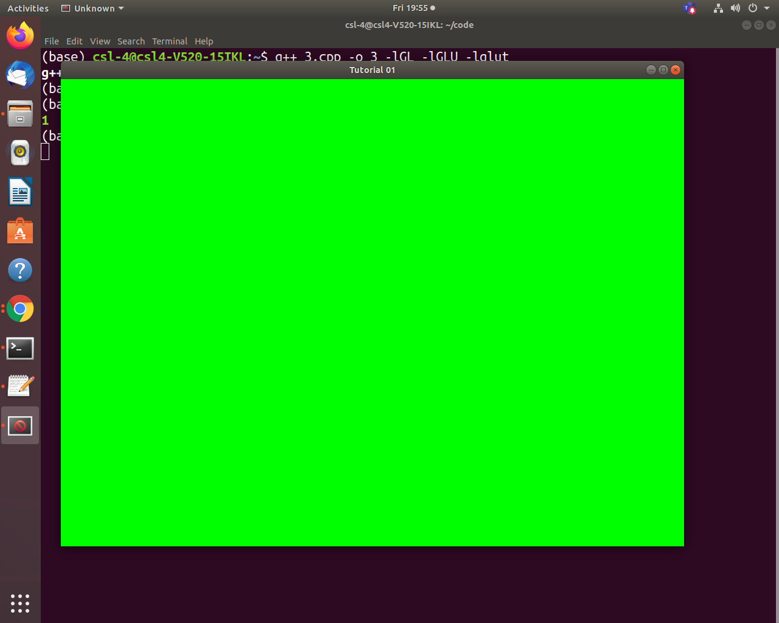
output

Slide 9

Thank You
Praveen.hore@gmail.com

